Slide 1




Compensating Room Effect with EQ
Hadi Sumoro

Slide 2

This article is a subset of a webinar about Sound System Optimization using FIR filters.
Originally presented in March 2021.

Slide 3


It’s always nice to start with a good sounding & well-behaved loudspeaker!
Our ear hears the sound from the loudspeaker and room reflections.
A room can’t make a bad sounding loudspeaker sounds better, and
a good sounding loudspeaker can’t make a bad sounding room sounds better.

Slide 4

Loudspeaker
Room
Puzzle 1: Loudspeaker layout & Choice
Puzzle 2: Room Acoustics
Puzzle 1 + 2 = A ‘marriage’ between a loudspeaker and a room
How can we make them happily married?

Slide 5

Compromise!
It’s easier for the loudspeaker to compromise. Use EQ(s),…
by factoring in the room effect.
Loudspeaker
Room

Slide 6
This article compares EQ creation for loudspeakers installed in a room by flattening the frequency response of the loudspeaker only vs flattening the averaged frequency response in the room.
Measure each listener position.
Create an averaged freq resp (spatial averages).
Make the average flat with FIR filter!
Measure 1x loudspeaker (outdoor / indoor with short windowing).
Make it flat on-axis with FIR filter!
Tech Info: Room impulse response is calculated using EASE AURA, auralization is done using EASE EARS.

Slide 7
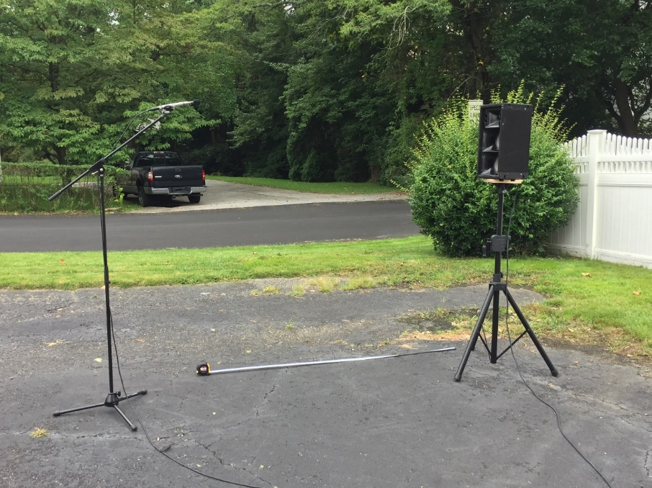
Loudspeaker in use: Community RS jr
Measurement was conducted outdoor as shown in the left picture.
Mic location: 2m away, 1.6m above the ground,
on-axis to the tweeter.

Slide 8
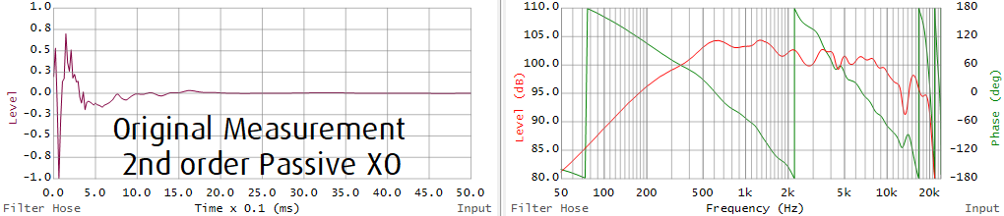
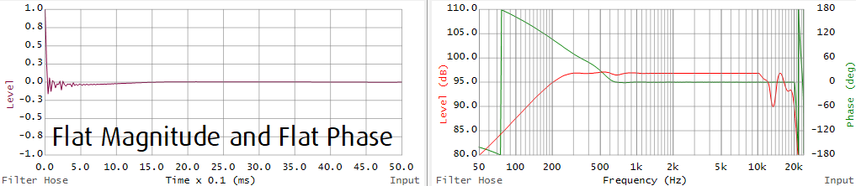
Picture above: Original Response, no EQ.
Picture below: Response after FIR filter.
Tech Info: Dual FFT using EASERA, Window length is approx. 7ms, FIR filter is created using Filter Hose.

Slide 9
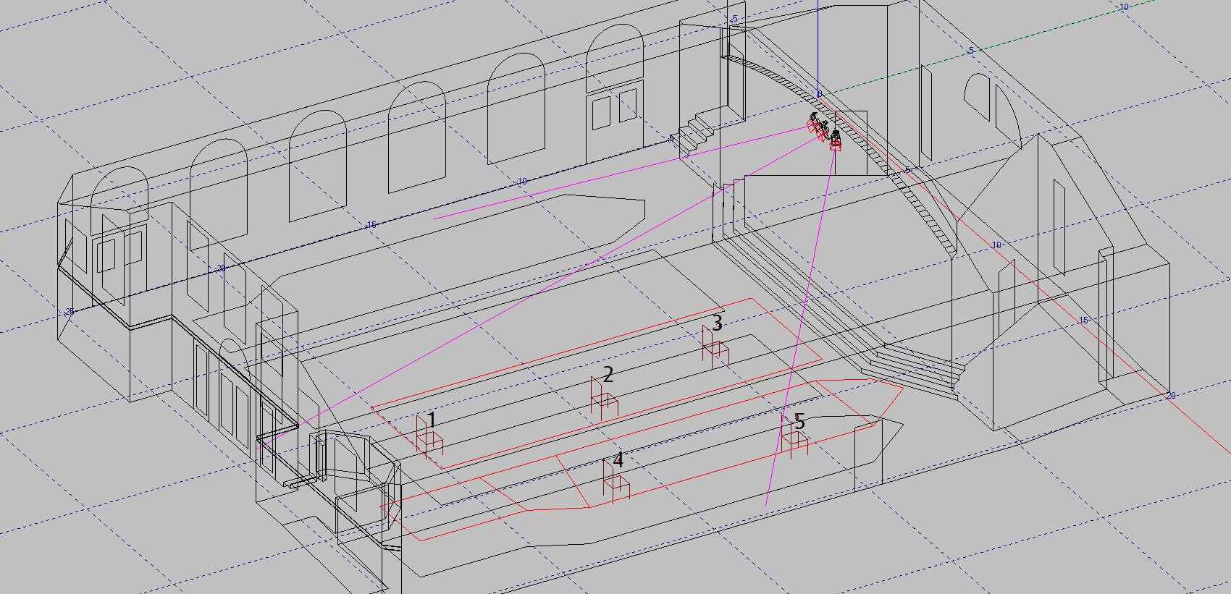
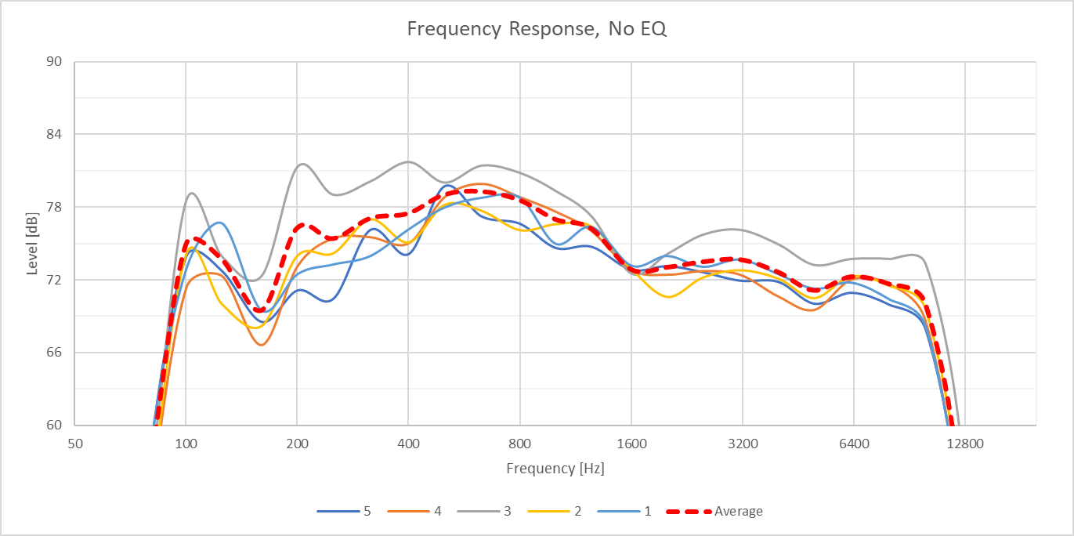
Room: A house of worship.
System: A Center Cluster consisting 3x RS jr loudspeakers.
Seats: 5x chosen listener positions that represents half side of the room (symmetrical room).
Loudspeaker On-Axis Response (no room effect) as shown in the previous page/slide. 1/12 oct smoothing.
Frequency Response on each chosen listening position (room effect is included). 1/3 oct smoothing.

Slide 10
Please use Headphones!
Click on the loudspeaker icons to play the sound.
PDF: Use Adobe Reader
PPSX: Requires Office 2016 or newer
The numbers represent the listener positions.

Slide 11
Listening 1
No EQ
Vs
EQ to flatten each Loudspeaker on-axis response

Slide 12
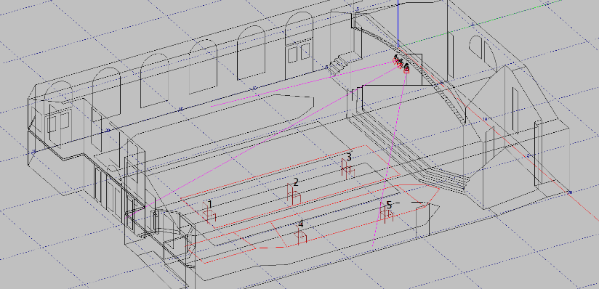

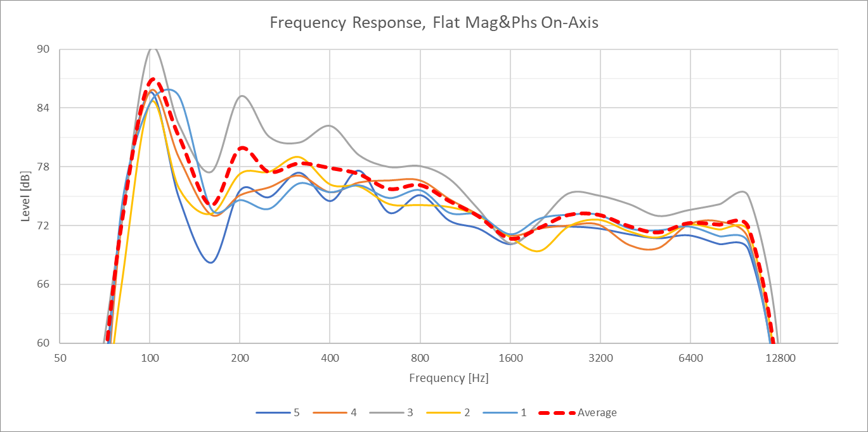
Sound System Optimization
Listener Locations,
With Room Effect
On-Axis Each Loudspeaker,
No Room Effect
No EQ
1
2
3
4
5
EQ: on-axis flat mag and phs
1
2
3
4
5
Listener Locations,
With Room Effect
On-Axis Each Loudspeaker,
No Room Effect

Slide 13
Listening 2
EQ to flatten the spatial average of the 5x chosen listener positions
Vs
EQ to flatten each Loudspeaker on-axis response

Slide 14
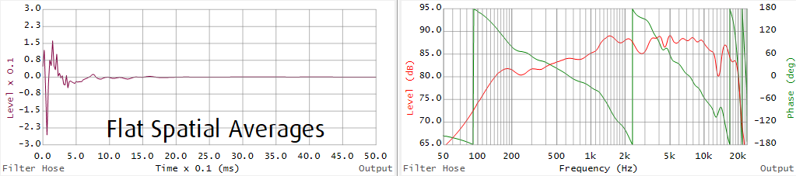
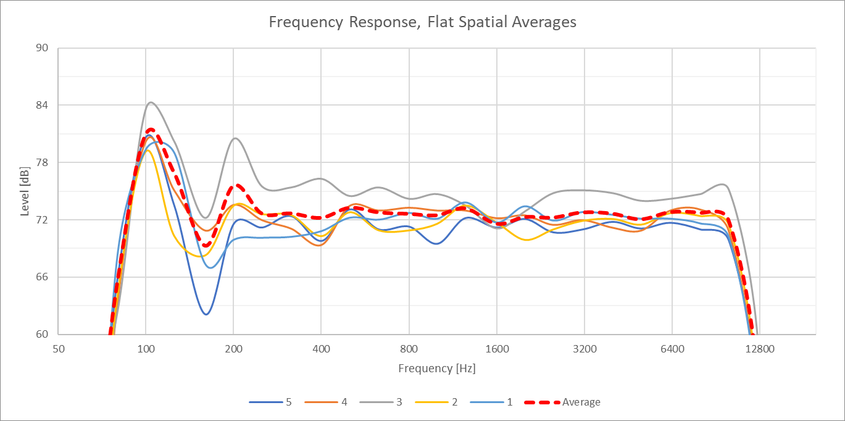
Sound System Optimization
Listener Locations,
With Room Effect
On-Axis Each Loudspeaker,
No Room Effect
EQ: calculated flat spatial average
1
2
3
4
5
EQ: on-axis flat mag and phs
1
2
3
4
5
Listener Locations,
With Room Effect
On-Axis Each Loudspeaker,
No Room Effect

Slide 15
So, should I create an EQ to compensate the loudspeaker with or without the room effect?
An EQ? How about several EQ curves and then combined?
It is important to understand that Sound System Optimization is not a process that can be tackled with one process of EQ creation.
To make loudspeakers ‘happily married’ with a room, EQ creations can contain several layers, for example:
One set of EQ from the manufacture (factory preset)
Second set of EQ to compensate room effect
Another set of EQ to fulfill subjective preference.
Another set of EQ to fulfill client’s subjective preference.
Etc.

Slide 16
THANK YOU!
Contact info:
Hadi Sumoro
HX Audio Lab
www.HXAudioLab.com
Song for auralization: Let’s Get Real, an original song of New Pony Funk’s band.

