Slide 1
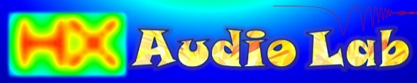
Sound Bubble Machine
Application Guide

Slide 2
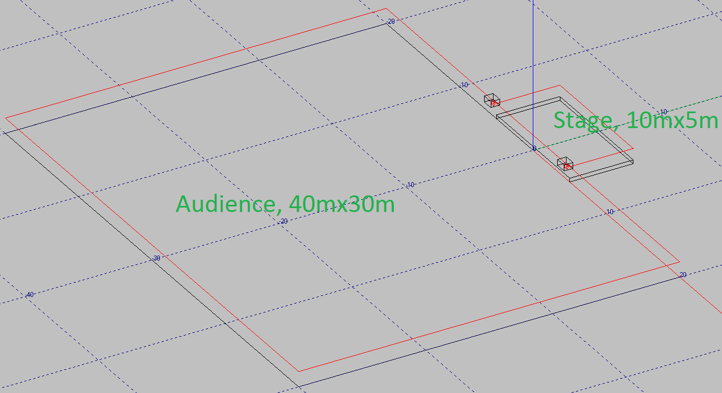
Sound Bubble Machine Application Guide
Rendering pictures information:
  Software: EASE 4.3.
  Subwoofer Data: RCF TTS26-A (GLL), double 15”, preset: 30-160Hz.
  Direct Sound Pressure Level rendering is calculated at 100Hz, 3 octave bandwidth sum.

Slide 3
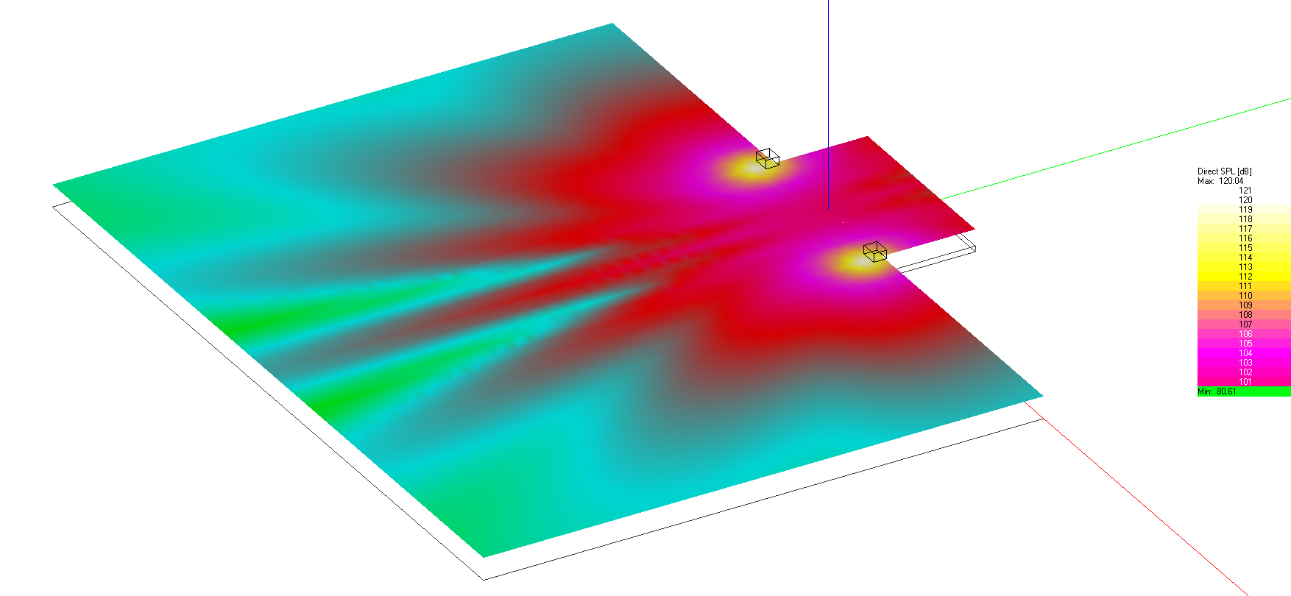
Omnidirectional at Low Frequency
Two subwoofers, located at left and right of the stage. Sound radiates omnidirectional to all direction.

Slide 4
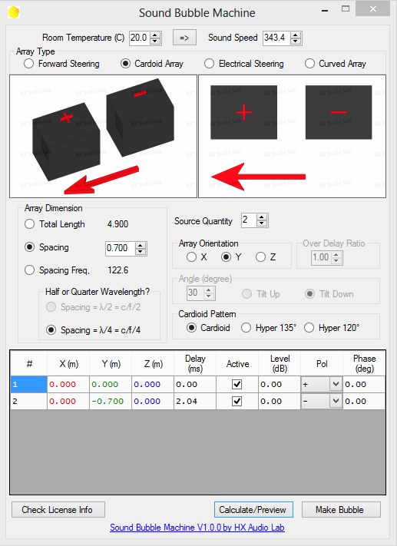
Cardioid Array
Cardioid array setup using two subwoofers (each side), 70cm spacing.

Slide 5
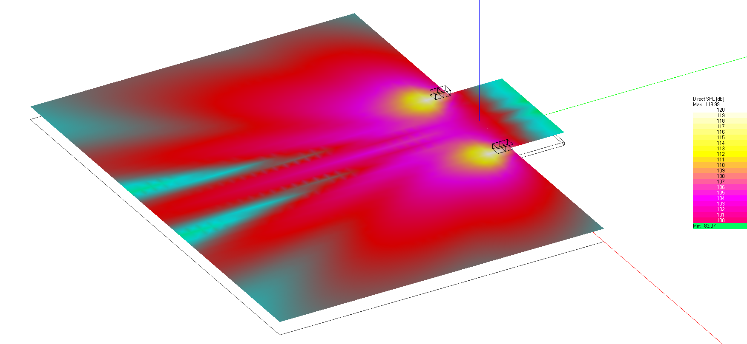
Cardioid Array
Low frequency sound is directed to the audience, less spill to the stage area.

Slide 6
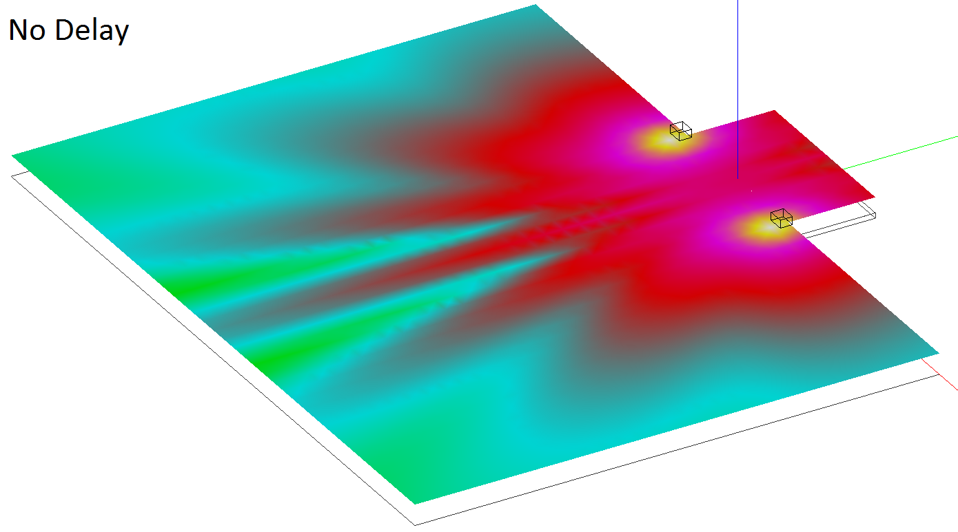
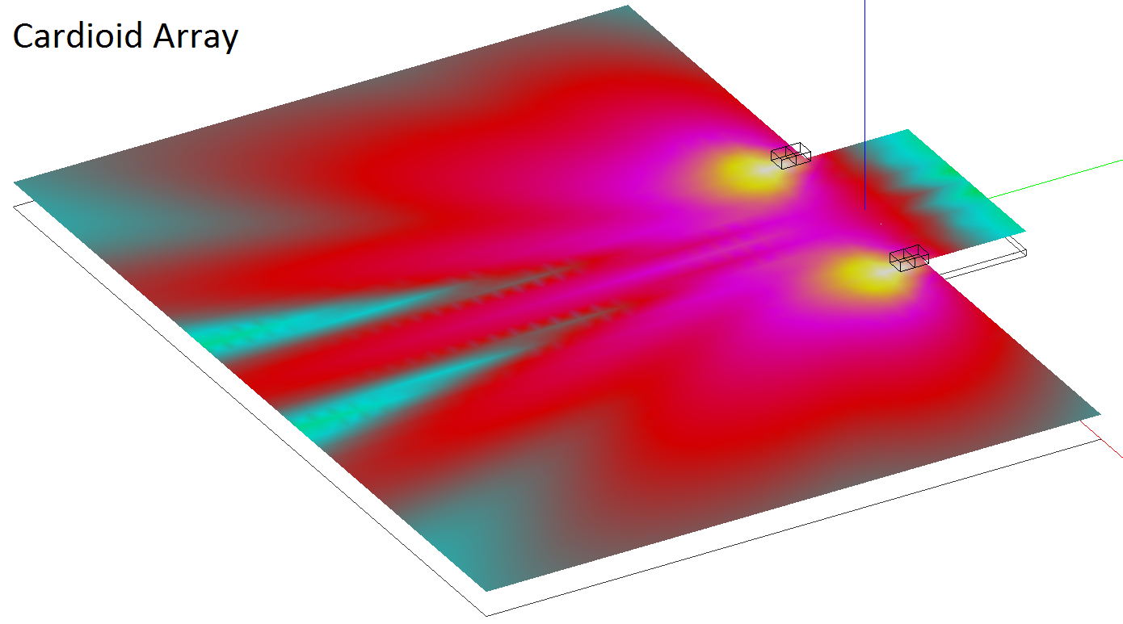
Cardioid Array

Slide 7
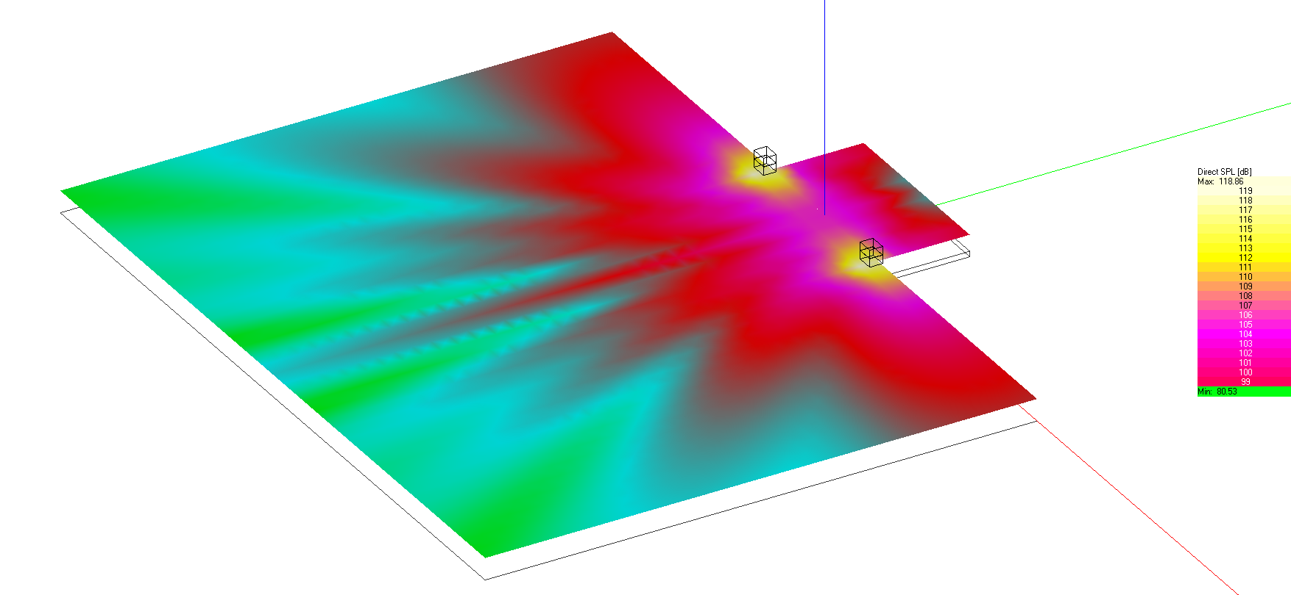
Cardioid Array
Same configuration, but stacked.

Slide 8
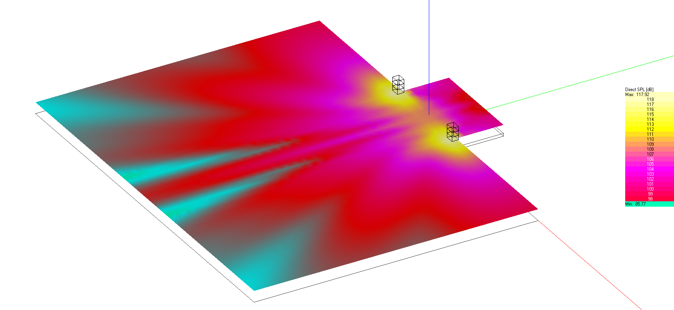
Cardioid Array
Same configuration per side, using two subwoofers facing forward (no delay, in polarity) and one facing backward (with delay, out of polarity).

Slide 9
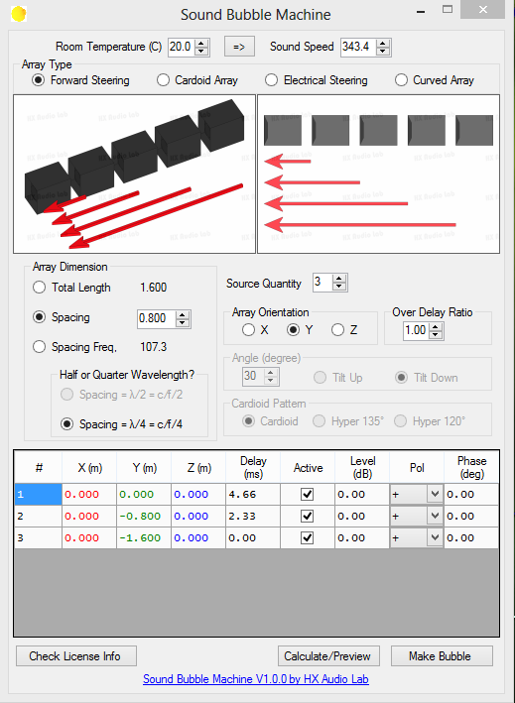
Forward Steering
Forward Steering with 80cm spacing between subwoofers.

Slide 10
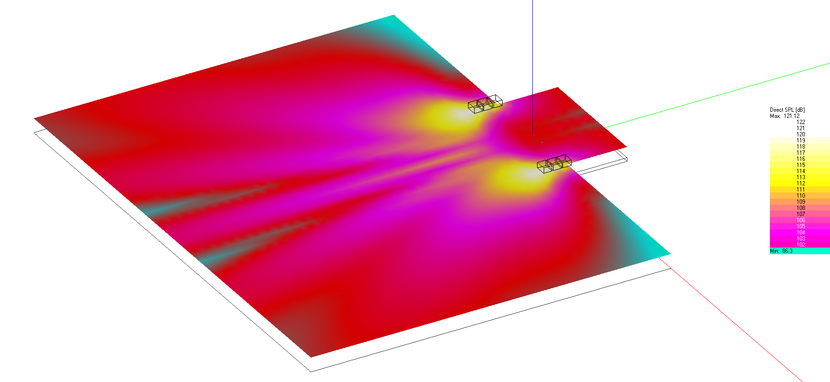
Forward Steering
Delay Ratio: 100%

Slide 11
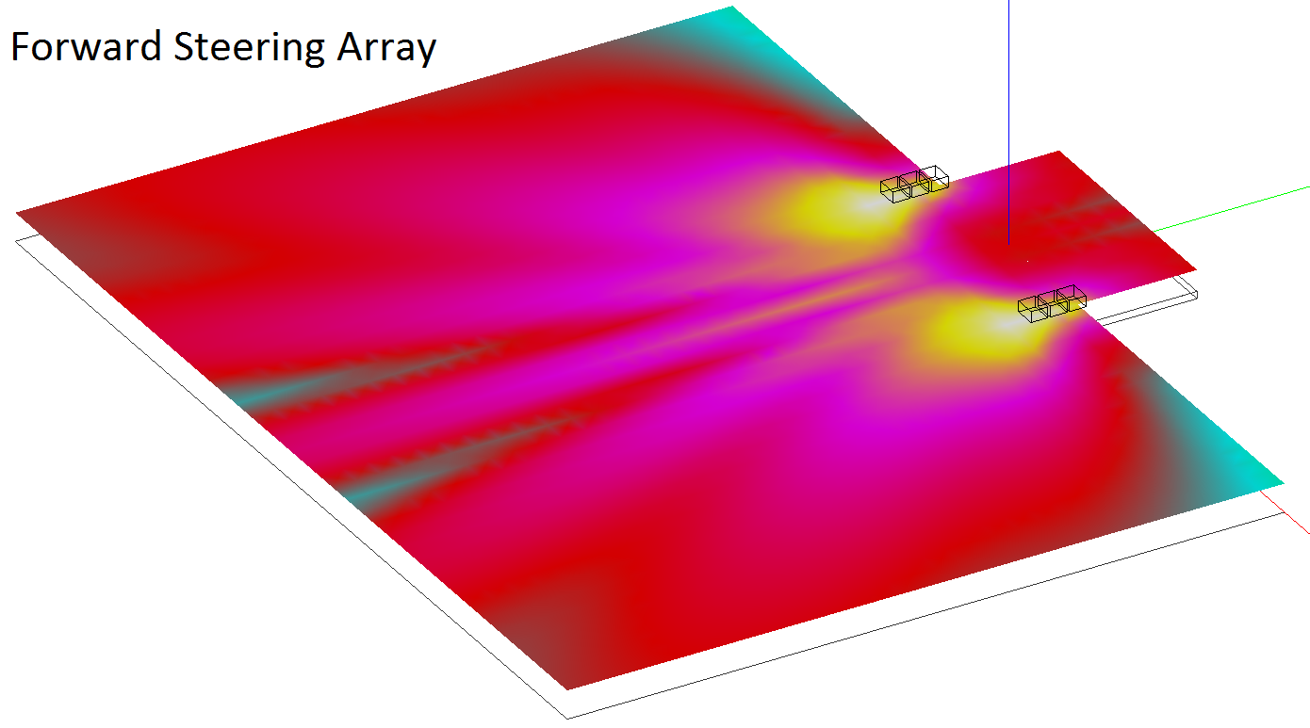
Forward Steering

Slide 12
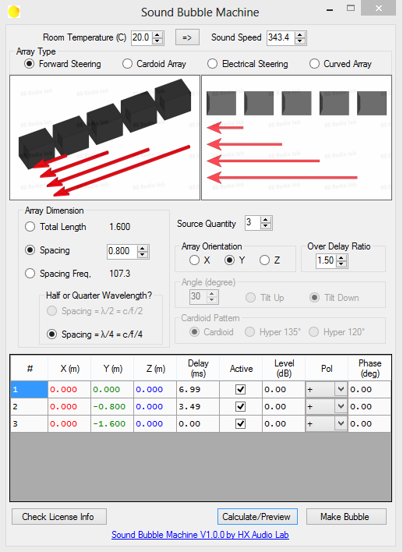
Forward Steering
Forward Steering with 80cm spacing between subwoofers. Delay ratio: 150%.

Slide 13
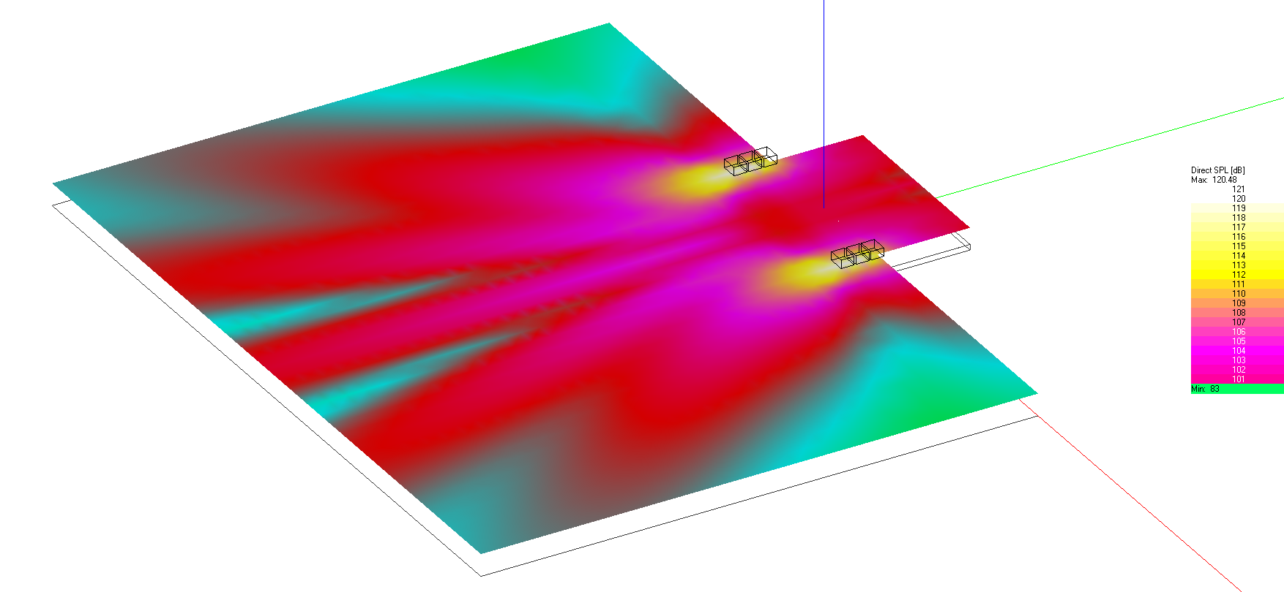
Forward Steering
Delay Ratio: 150%.

Slide 14
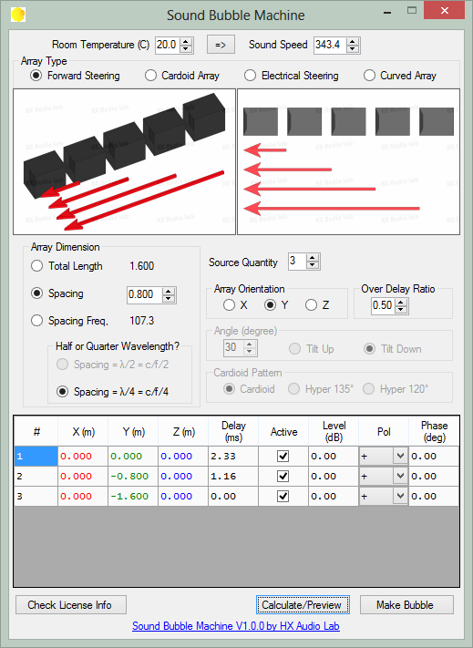
Forward Steering
Forward Steering with 80cm spacing between subwoofers. Delay Ratio: 50%.

Slide 15
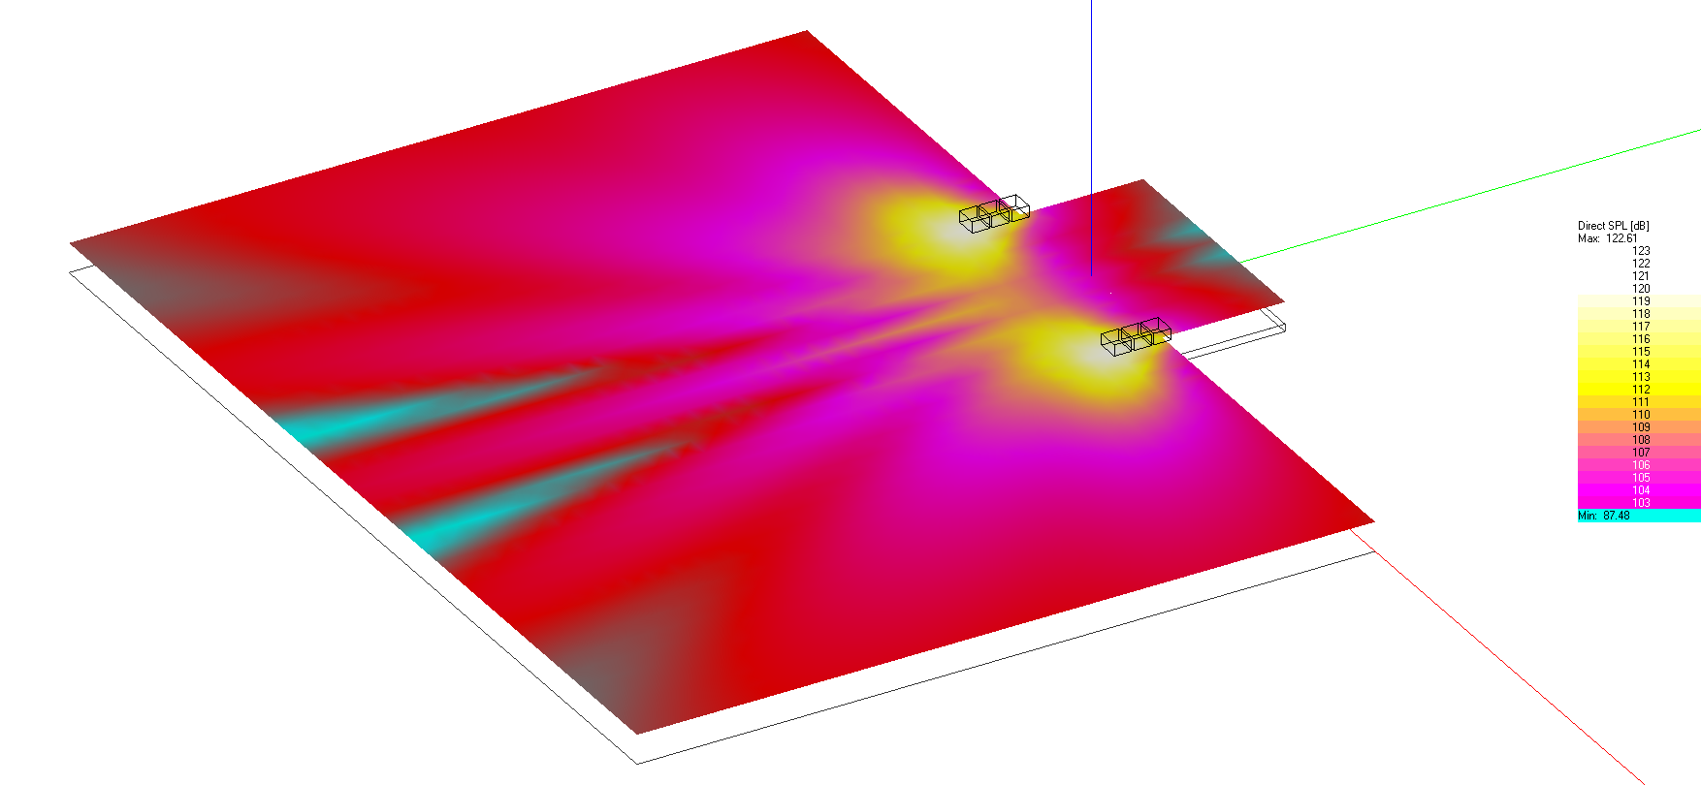
Forward Steering
Delay Ratio: 50%.

Slide 16
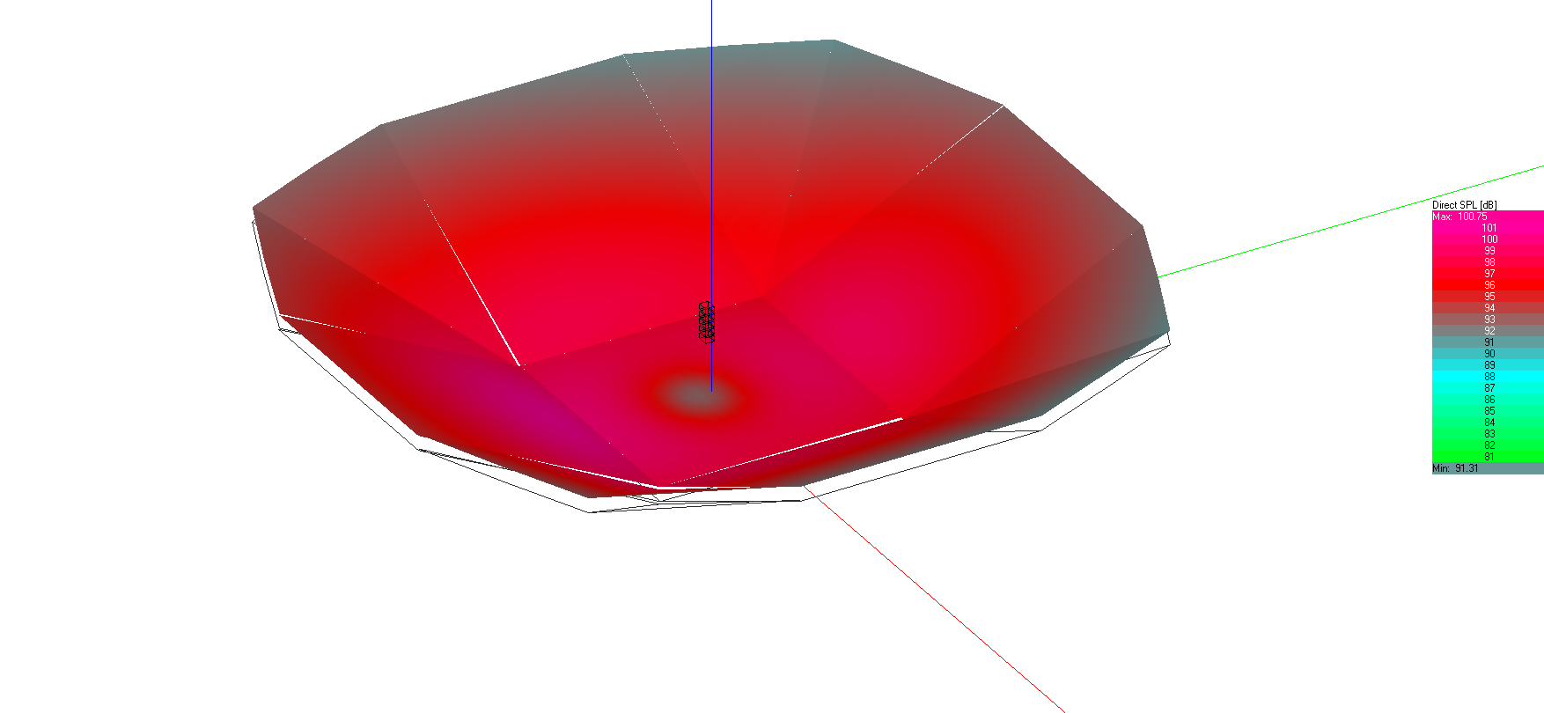
Electrical Steering
Five subwoofers in the middle arena (above the main stage) in a straight array.

Slide 17
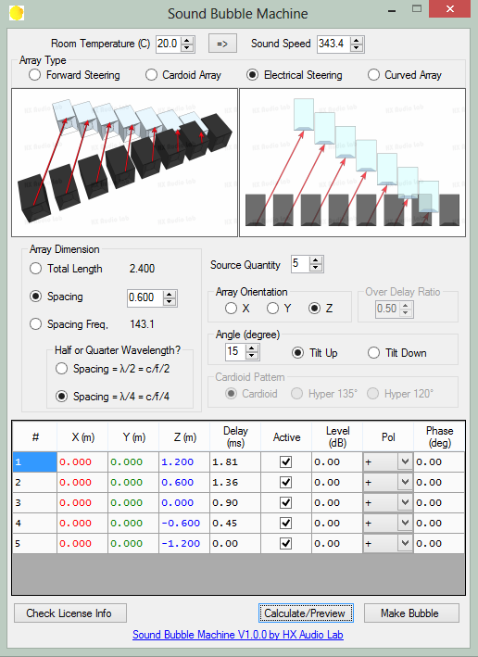
Electrical Steering
Electrical steering to aim the main sound lobe 15deg upward, more to audience area.

Slide 18
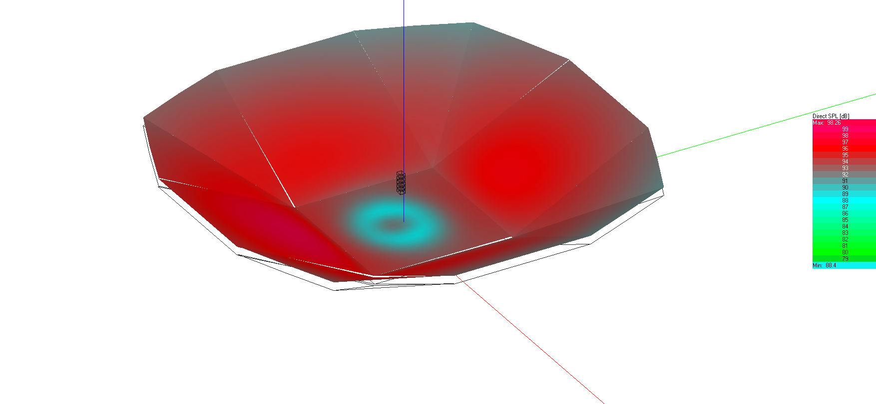
Electrical Steering
Using delay time calculated to aim the sound lobe 15deg upward.

Slide 19
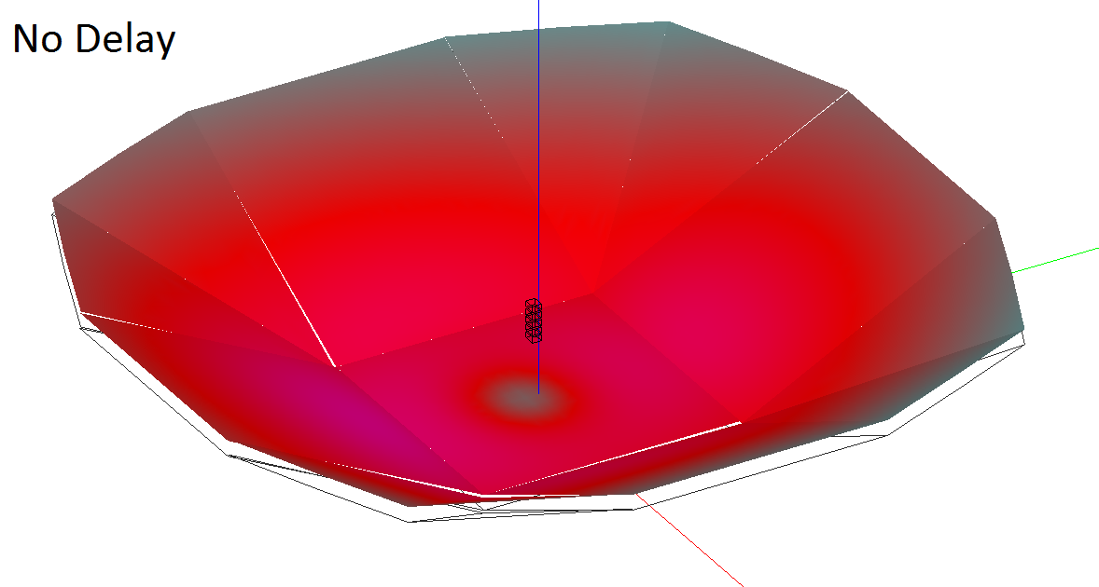
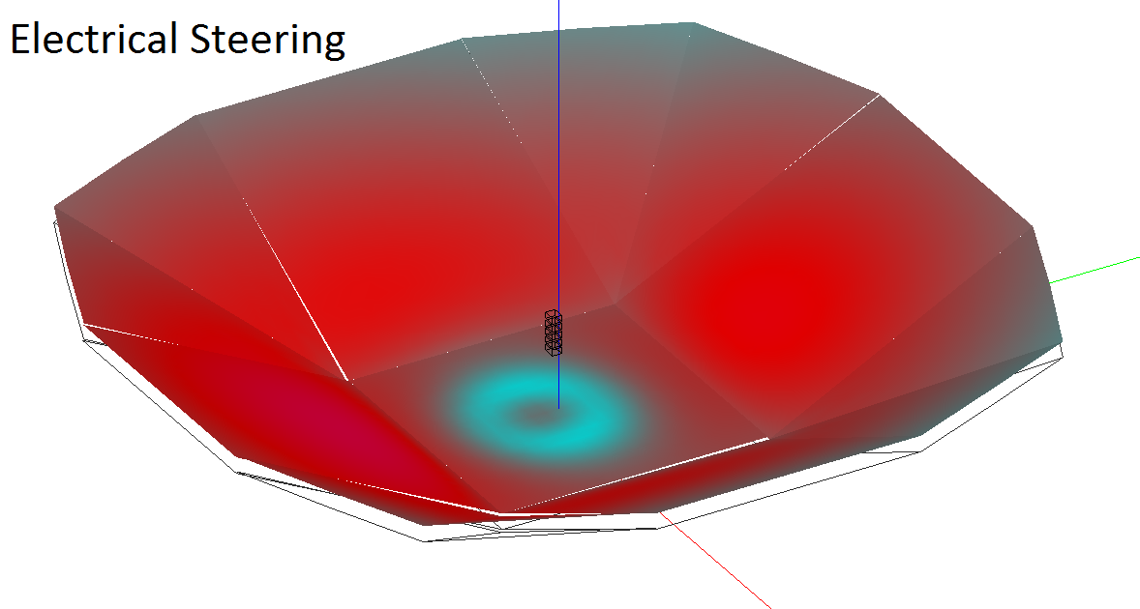
Electrical Steering

Slide 20
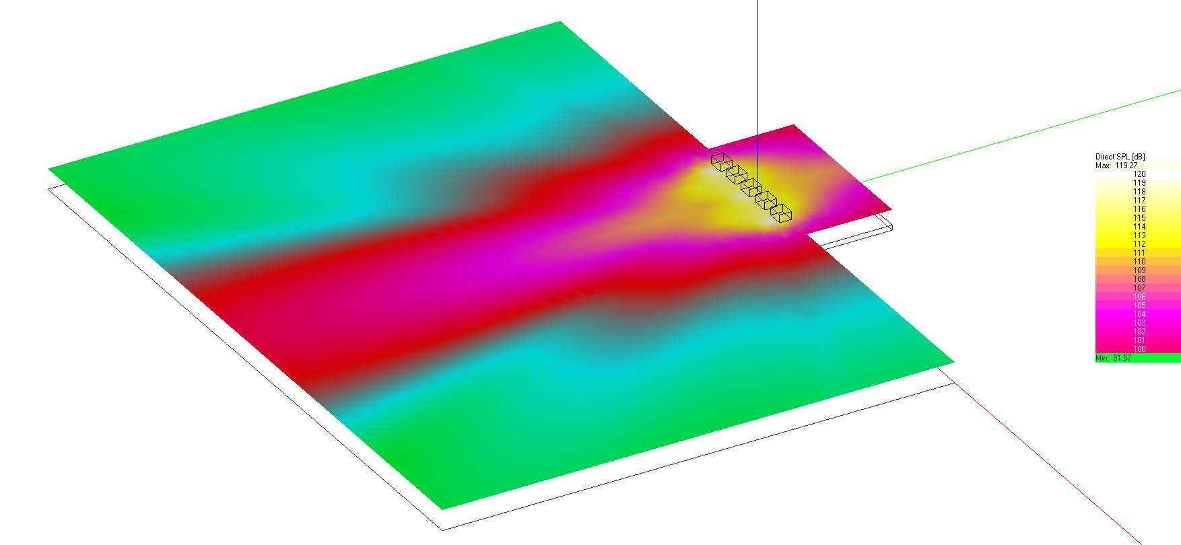
Curved Array
Five subwoofers in a straight array (1.5m spacing between subwoofers) in the front of the stage.

Slide 21
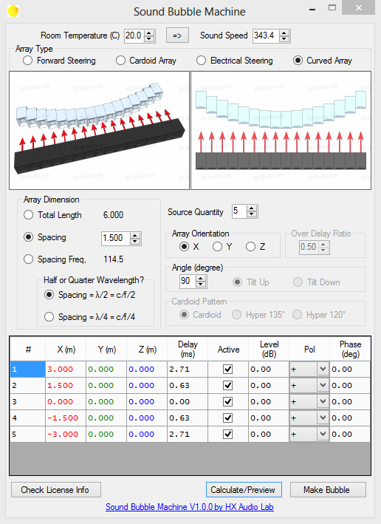
Curved Array
Adding delay to the straight array to create an imaginary curved array (90deg arc).

Slide 22
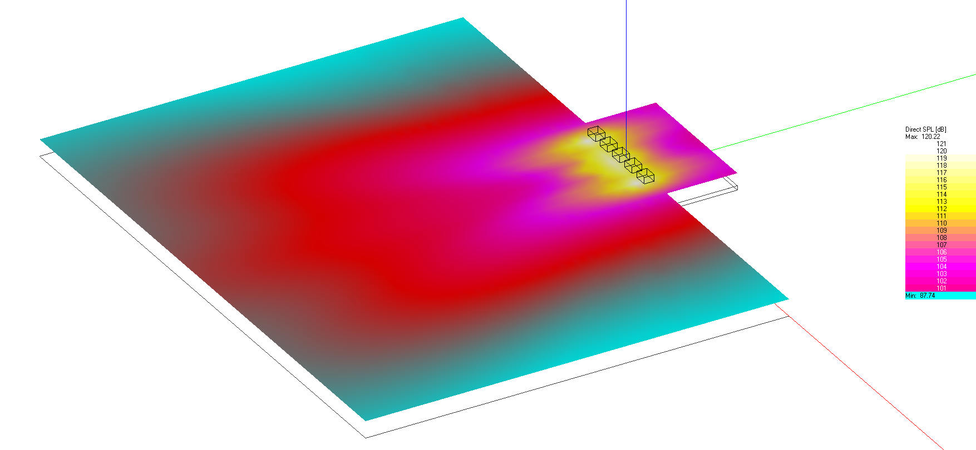
Curved Array
Straight array with delay to create an imaginary curved array (90deg).

Slide 23
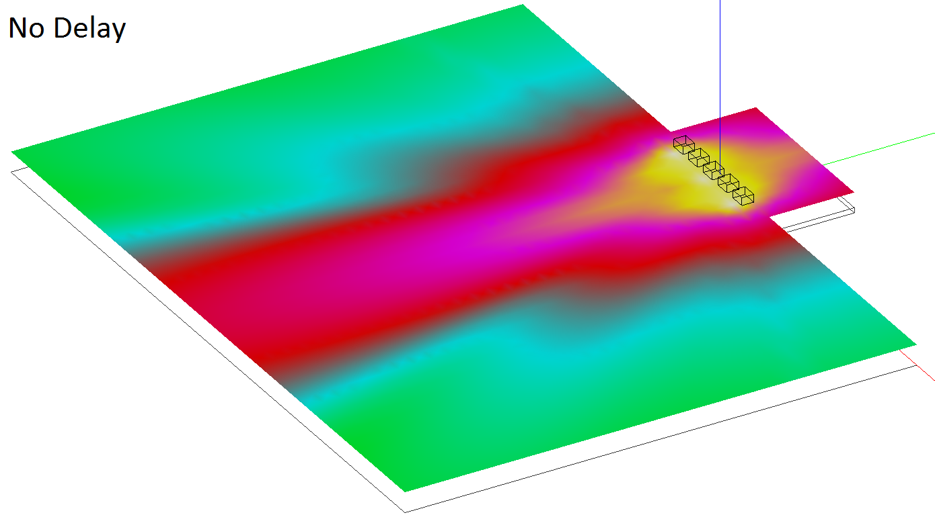
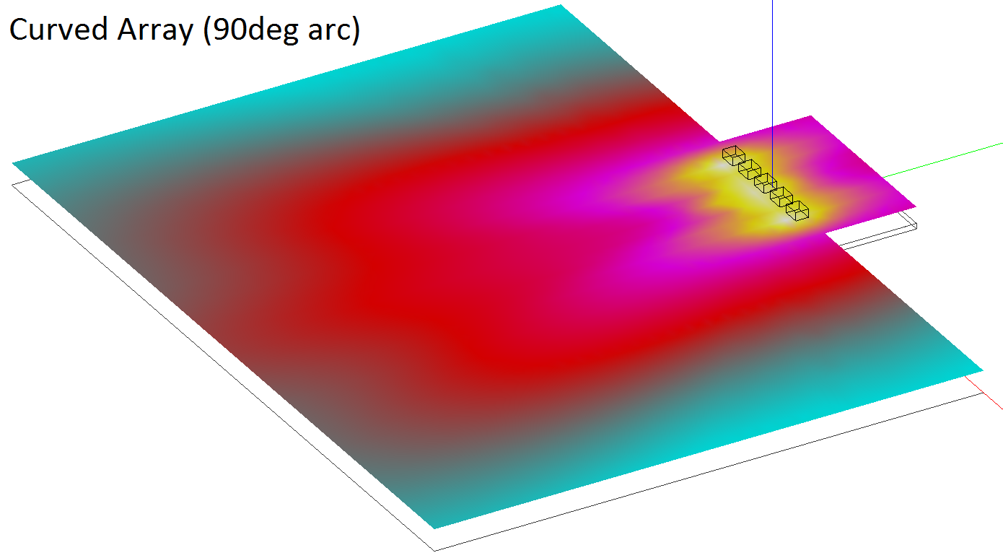
Curved Array

Slide 24
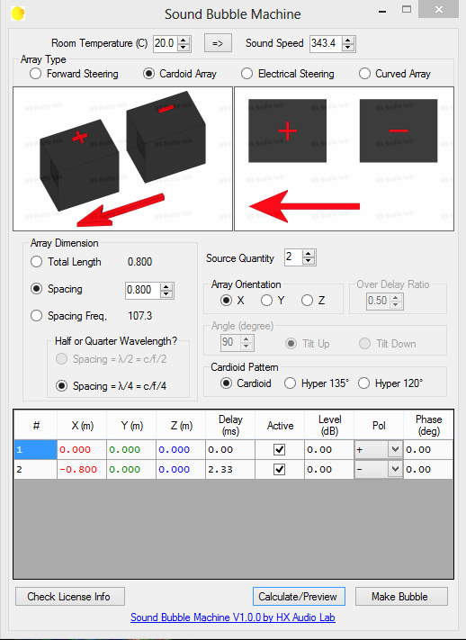
Curved Array and Cardioid Array
Adding subwoofers and extra delay to combine curved array and cardioid array configurations.

Slide 25
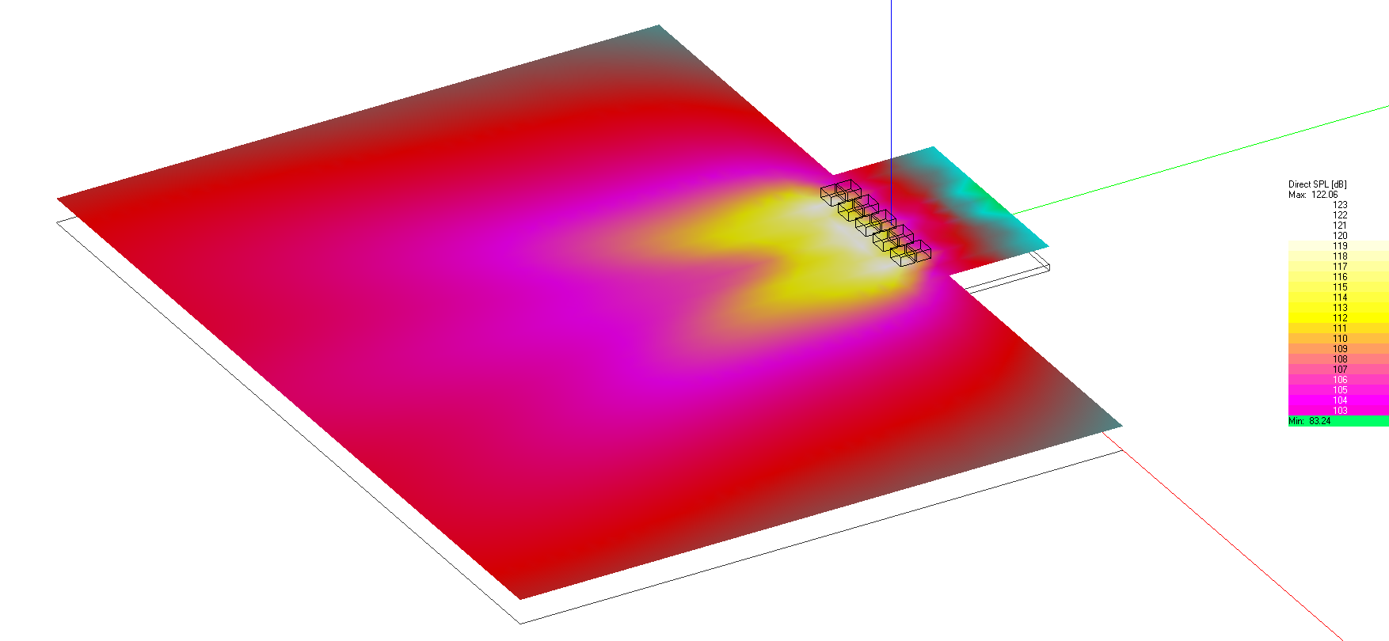
Curved Array and Cardioid Array
Straight array with delay to create an imaginary curved array (90deg), combined with cardioid array with 80cm spacing to the back subwoofer (out of polarity).

Slide 26


Sound Bubble Machine

