Slide 1
Sound Splash is a calculator to design custom diffusers such as Schroeder diffusers, Huffman sequence diffuser, etc. Sound Splash is capable of making combinations of one dimensional QRD, PRD, LSD, PWRD, Huffman sequence (non-integer based sequence) and two dimensional QRD, PRD, LSD, Huffman. A sub-program for designing a two dimensional maximum length sequence (MLS) diffuser is also included. The two-dimensional diffusers can be calculated using array calculation (simple method) and Chinese Remainder Theorem.
Basic steps：
1. Open “build component diffusers” window to create a single diffuser.
2. Hit “send” button to transfer the diffuser data to the main window. You can combine different type of diffusers. When you are done, close the build component diffusers window.
3. Hit “generate complex diffuser” button.
4. Export picture, data and report
5. Hand in the data to Mr. Carpenter.

Slide 2
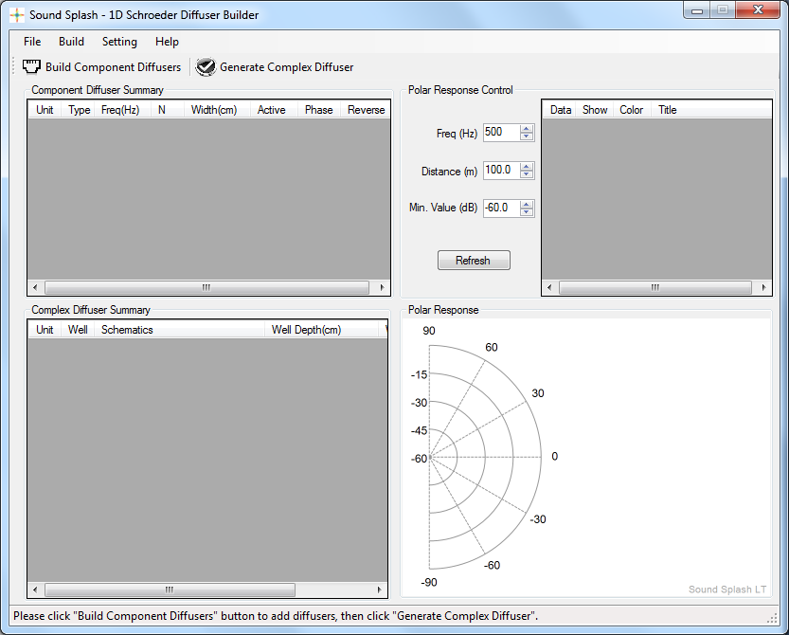
Generate the whole diffuser array.
This table saves the polar response calculation results.
[First step] Open this window to create single diffuser.
You can temporarily deactivate a diffuser
This table saves single diffusers you created from build component diffusers.
This table gives the full view of the generated diffuser.
This area shows the polar response *Sound Splash does not use BEM

Slide 3
Let’s take a look at the basic functions by making a 1D QRD.

Slide 4
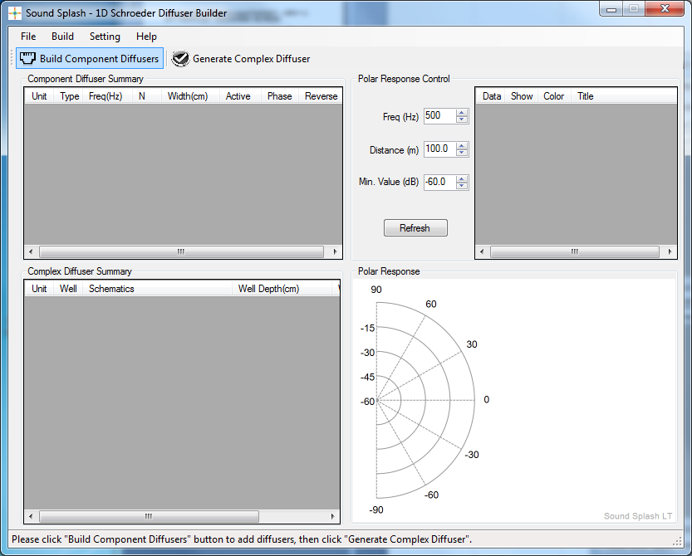
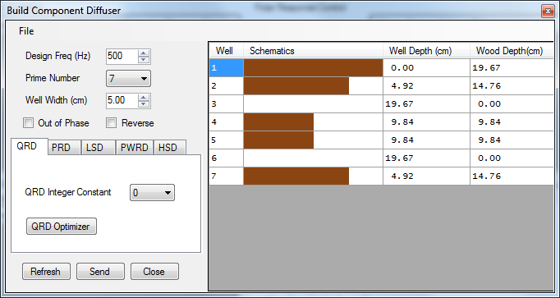
1. Click here to open the component diffuser window.
2. Define diffuser’s general parameters.
3. Select a diffuser type and define the specific parameters.

Slide 5
Data of the single diffuser. Depth is relatively drawn in scale.
Transfer data to the main window.
Hit refresh to apply changes. Shortcut: Enter or double click.
After you are done, close this window to return to the main window

Slide 6
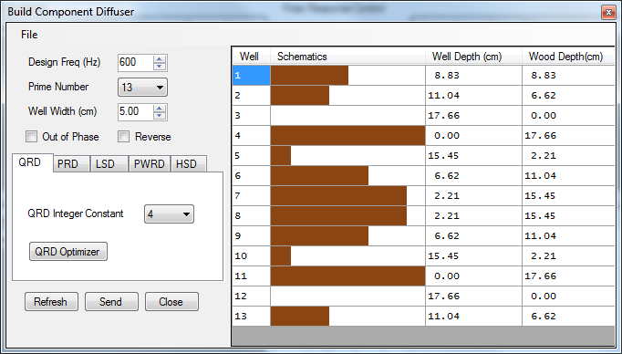
Let’s create a QRD with N=13, design frequency=600Hz, well width=5cm, Integer constant=4.
Hit Refresh and Send (once). You should see the diffuser is listed in the main window, and hit
“Close” button to return to the main window.

Slide 7
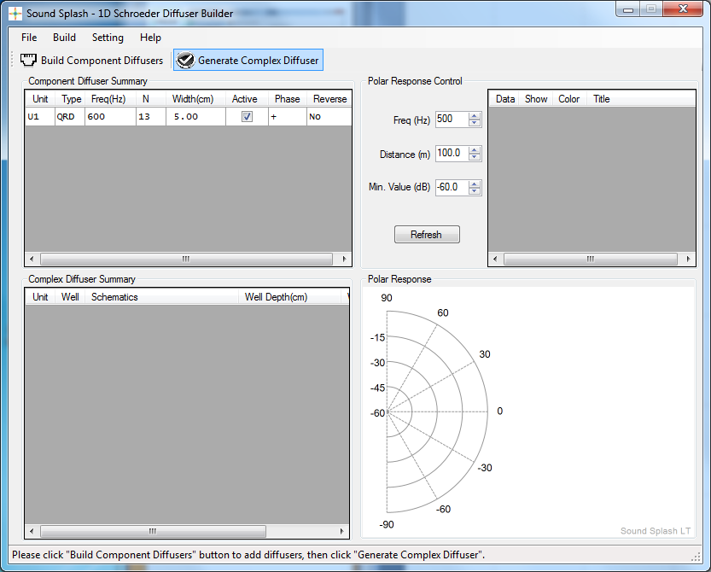
Click here to calculate the total diffuser
You will see the newly created diffuser(s) here.

Slide 8
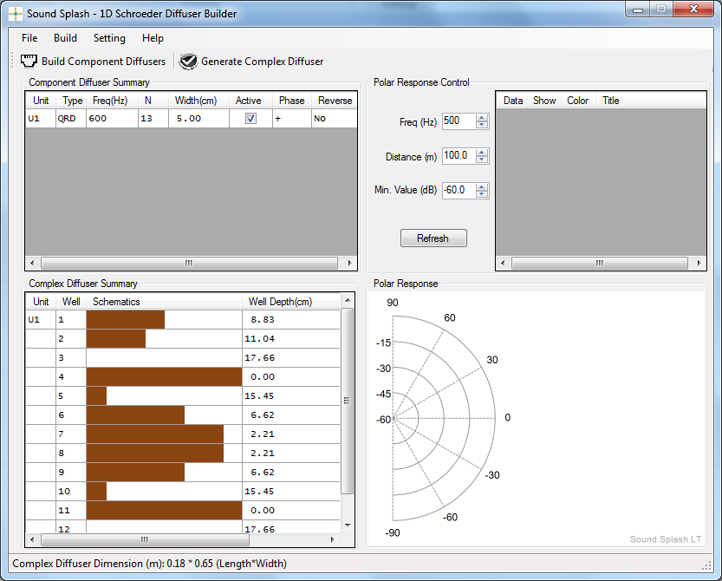
Click here to calculate the polar response

Slide 9
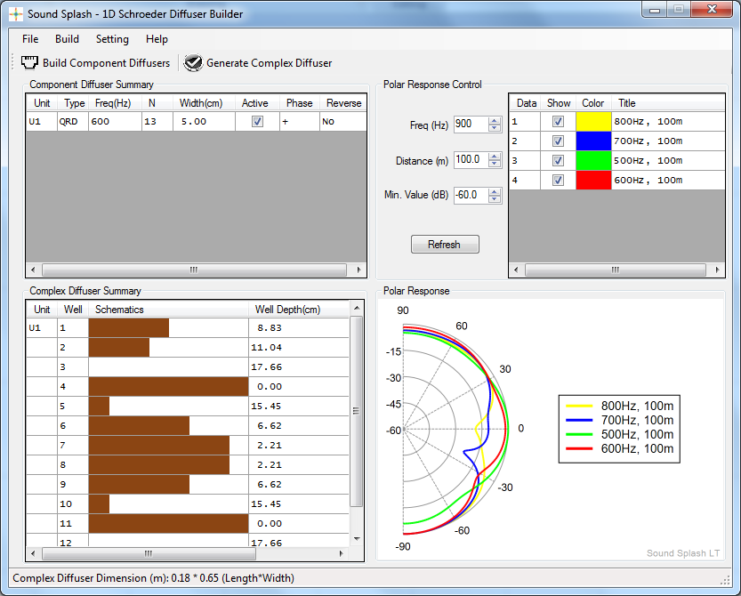
Try changing the polar response frequency to 500Hz, 600Hz, 700Hz and 800Hz and overlay all polar curves.

Slide 10
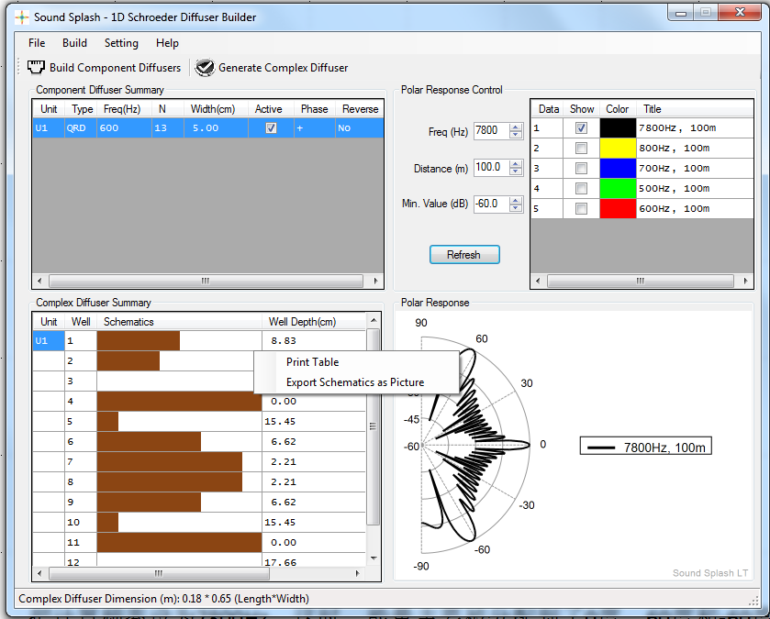
Using right mouse button, you can print this table, or export picture.

Slide 11
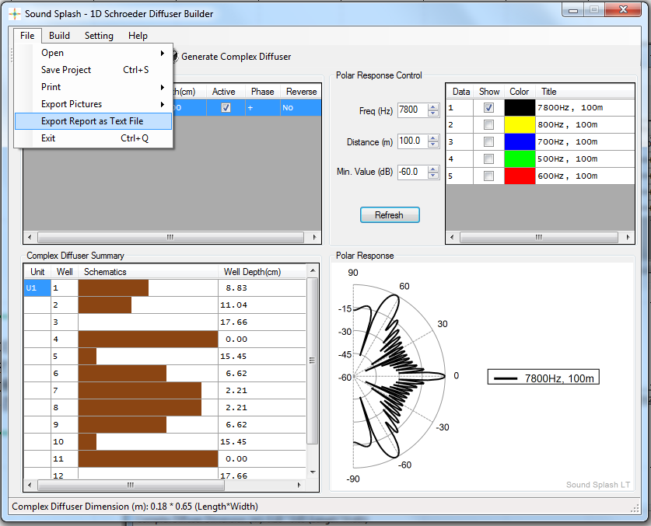
More functions under the file menu.
Right click this window to see more functions such as adding extra well to make a symmetrical construction.

